Slide 1
EPCRA Overview
CO Chemical Safety Workshops for Regulated Facilities
(8-10

Slide 2
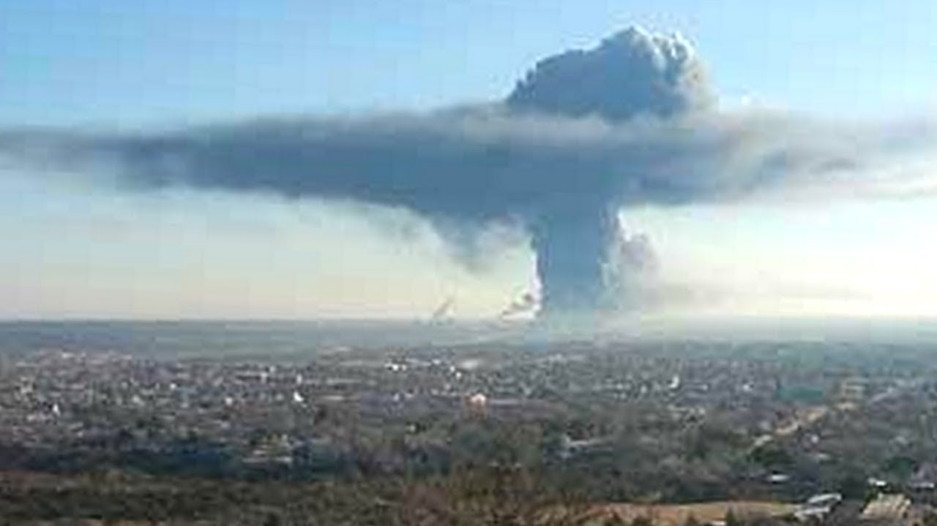
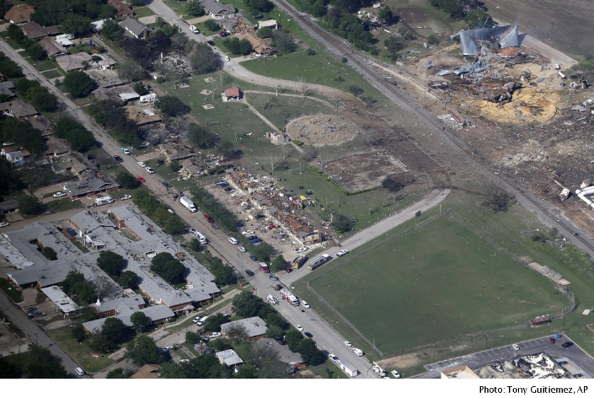
EPCRA Purpose
To help communities plan for emergencies involving accidental releases of hazardous substances by mandating planning by federal, state, local governments, tribal nations and industry.

Slide 3
What is EPCRA about?
Chemicals-
What chemicals are in the community?
What training and/or equipment does the community need for those chemicals?
Information-
Industry provides chemical hazard information to SERC/LEPC/Fire Departments.
LEPC can plan for chemical safety.
Local Communities-
Everything is local. Response and planning to local hazards are all based on local partnerships

Slide 4
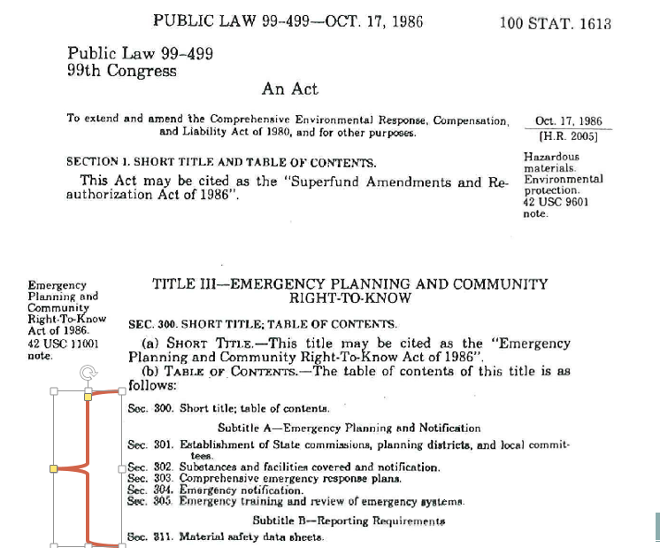
Requirements under EPCRA
Section 301
Section 302
Section 303
Section 304
Section 311
Section 312
Section 313

Slide 5
Section 301-Establishes SERC/TERC/LEPC
SERC/TERC main responsibilities:
Appoint, supervise and coordinate LEPC activities (designate emergency planning districts).
Receive copies of Tier II reports and manage that information.
Review and approve emergency plans (developed by LEPCs).
Establish public info request procedures

Slide 6
Section 301-Establishes SERC/TERC/LEPC
What is the role of the LEPC?
Partnership formation with local governments and industries for hazmat planning.
Analyze local hazards
Develop and maintain Emergency Plan
Assess response capabilities
Conduct training and exercises.
LEPCs can serve as a community focal point for information and discussion.
Notes:
Do you know what a LEPC is? You as a facility are an important part of this.

Slide 7
Section 302-Emergency Planning Notification
If a facility has an EHS over the limit (TPQ) in the List of Lists:
facility must provide a written notification within 60 days to the SERC and LEPC.
facility must then designate an emergency coordinator who can assist with development and implementation of a local emergency plan.
Notes:
No format for 302 reporting
EHS-extremely hazardous substance (there’s about 500)
TPQ-Threshold Planning Quantity

Slide 8
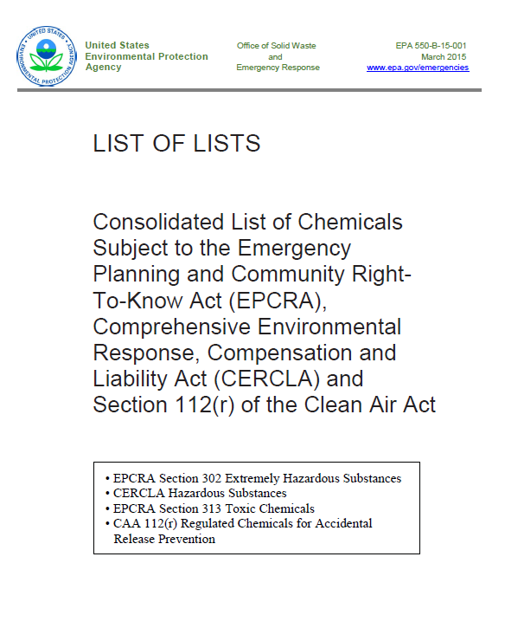
http://www2.epa.gov/sites/production/files/2015-03/documents/list_of_lists.pdf
Notes:
We are also going to refer to this a lot. Sadly the title is more accurate than anyone would want to believe

Slide 9
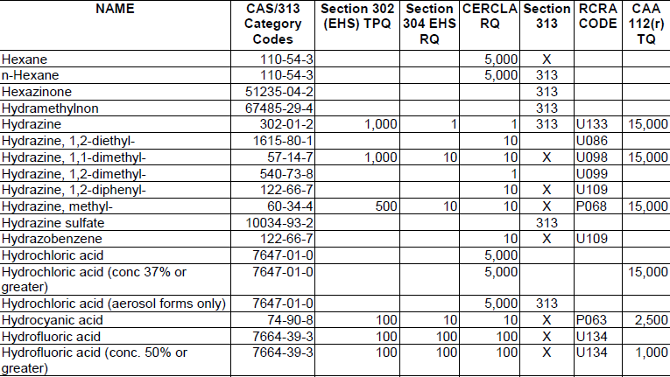
Section 302-Emergency Planning Notification
Notes:
No format for 302 reporting

Slide 10
Section 303- Emergency Planning
LEPCs need to:
Develop an emergency response plan for the community.
Develop procedures for public requests for info
→This section gives authority to LEPCs to request and obtain information from facilities relevant to emergency planning.
Notes:
EPCRA section 322 allows for trade secrets. LEPCs not looking to exploit secrets-just ensure there are capabilities to respond.

Slide 11
Section 304- Spill of an EHS
When release or spill occurs of an EHS over the Reportable Quantity (RQ) in the List of Lists, a facility must make immediate notifications.
Notes:
Sister provision to CERCLA 103-all levels of government are notified of potential emergencies

Slide 12
Section 304- SPILLS – When in doubt, report it out

Slide 13
Section 304- SPILLS – Who to call
National Response Center
(800) 424-8802
LEPC and SERC immediately
Also follow with written report (within 2 weeks)
(CO’s 24 hour number 877-518-5608)
Notes:
Sister provision to CERCLA 103-all levels of government are notified of potential emergencies
This is to ensure all levels of government are notified of potential emergencies

Slide 14
Section 311/312 Chem Reporting and TIER II
If a facility stores an EHS at TPQ or 500 lbs (whichever is less)
-or-
A hazardous chemical requiring a SDS in an amount over 10,000 lbs.
311-1st time obtain chem in question submit SDSs w/in 90 days to SERC/LEPC/Local Fire Dept.
312-must submit Tier II report to the LEPC, SERC, and local fire dept annually.
Notes:
This of course in the Tier II reporting format

Slide 16
Important!
March 1, 2017
Tier II reports due to the SERC, LEPC, and Fire Departments for the year 2016.
Email: cdphe.edtier2submit@state.co.us
Webpage: https://www.colorado.gov/pacific/cdphe/tier-ii-hazardous-chemical-inventory-reporting
Notes:
Each state has their own requirements, so be sure to check with your state

Slide 17
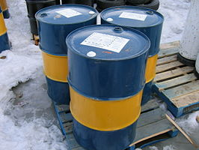
Section 313-Toxics ReIease Inventory
TRI-is designed to give public access to information on presence, annual releases and waste management.
*A facility who manufactures, processes, uses or disposes for each qualifying chemical in the List of Lists to submit a ‘Toxic Release Inventory’ report (TRI).
Notes:
Only part of EPCRA where data is exchanged b/w EPA and industry. Everything else between locals and industry.
New approach to environmental protection-incentivize improving environmental performance to companies.

Slide 18
Section 313- TRI
Notes:
“x”-this is a 2nd name for the chem already on the list. indicates chemical with same CAS number appears on the lists with a different chemical name.

Slide 19
What’s new in EPCRA?
OSHA’s Hazard Communication Standard (HCS) was revised to conform with UN’s system of classification and labeling of chemicals.
EPA amending reporting in 311 and 312 (Tier II) to reflect these changes for the 2017 Reporting Year (not until March 2018).
EPA had modified OSHA’s 23 physical and health hazards into 5 categories for reporting, effectively undoing that.

Slide 20
Resources
The List of Lists
EPA EPCRA Website
http://www.epa.gov/epcra
Google search – EPCRA
EPCRA Hotline (800) 424-9346
Tier2 Submit software HELP function

Slide 21
What can be done on the local level?
PLAN AND PREPARE
RESPOND EFFECTIVELY
PREVENT THE ACCIDENT

Slide 22
EPA EPCRA Contacts:
Breann (Bre) Bockstahler
Emergency Preparedness
bockstahler.breann@epa.gov
303-312-6034
Lori Reed
SEE-Emergency Preparedness
reed.lori@epa.gov
303-312-6190

