Slide 1

Medical Countermeasures and Closed POD Planning
Melanie Simons,
SNS Program Manager

Slide 2

Strategic National Stockpile
Created in 1999
Federally controlled cache of medical countermeasures (medical supplies, antibiotics, antivirals, antidotes, antitoxins, vaccines and other pharmaceuticals)
Network of strategically located repositories that can be deployed within 12 hours to anywhere in the U.S.
Notes:
The SNS is a cache of medical supplies and medications that can be quickly deployed in an emergency
Once the Governor requests the SNS, the first supplies can be pushed out anywhere in the country within 12 hours; these are general supplies
After the specific needs are identified, the Managed Inventory will be sent
The MI contains stockpiles of supplies for specific events
If there is a need for supplies that are not already stockpiled, CDC has the purchasing channels to obtain them
During the 1st wave of illness, Public Health will use the Strategic National Stockpile to distribute supplies to combat pandemic influenza
Ventilators, masks, gloves, medications, extra hospital beds
Between the 1st and 2nd waves, it is possible that a vaccine will become available; this will also be sent via the SNS

Slide 3
Strategic National Stockpile
Can only be requested by CDPHE with recommendation of the Governor’s Expert Emergency Epidemic Committee (GEEERC)
Two stages:
  12-Hour Push Packages containing generic meds and supplies
  Managed Inventory (MI) for specific events
  If there is a need for supplies not stockpiled, CDC can purchase elsewhere (eg. DOD or VA)
Notes:
The SNS is a cache of medical supplies and medications that can be quickly deployed in an emergency
Once the Governor requests the SNS, the first supplies can be pushed out anywhere in the country within 12 hours; these are general supplies
After the specific needs are identified, the Managed Inventory will be sent
The MI contains stockpiles of supplies for specific events
If there is a need for supplies that are not already stockpiled, CDC has the purchasing channels to obtain them
During the 1st wave of illness, Public Health will use the Strategic National Stockpile to distribute supplies to combat pandemic influenza
Ventilators, masks, gloves, medications, extra hospital beds
Between the 1st and 2nd waves, it is possible that a vaccine will become available; this will also be sent via the SNS

Slide 4
What is a Medical Countermeasure (MCM)?
Interventions used to prevent, mitigate, or treat the adverse health effects of an intentional, accidental, or naturally occurring public health emergency
Pharmaceutical interventions, such as vaccines, antibiotics, antivirals, antidotes, and antitoxins
Non-pharmaceutical interventions, such as ventilators, diagnostics, personal protective equipment (PPE), and patient decontamination equipment

Slide 5
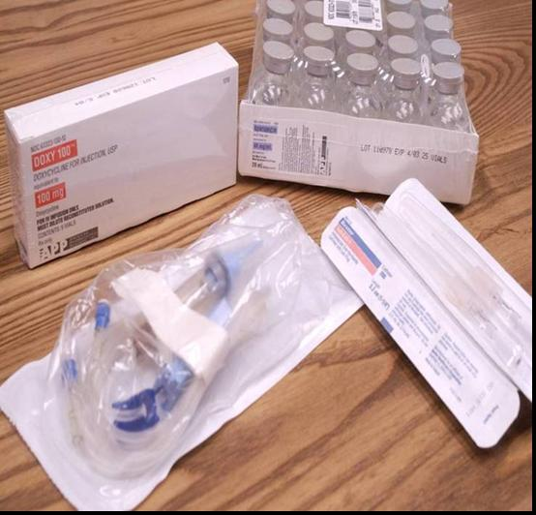
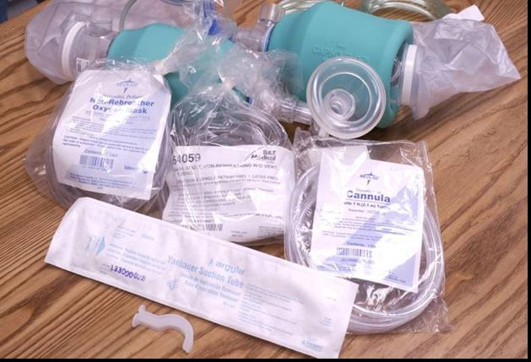
SNS Medical Countermeasures
Pharmaceuticals
  Antibiotics (Oral and IV)
  Vaccines and Antitoxins
  Antivirals
  Radiation Countermeasures
  Nerve Agent Antidotes
Non-Pharmaceutical Medical Supplies
  IV Administration
  Airway Management
  Wound Care
  Burn & Blast Care
  Masks, Respirators, & Ventilators
  Gloves and Gowns
Notes:
Say:
Shown here is a representation of some aspects of our formulary.
Note that we maintain both oral and intravenous antibiotics and that our airway maintenance supplies are appropriate for both adult and pediatric needs.
Antibiotic Background Information (Don’t volunteer this; to be used to help answer questions only)
Doxycycline (IV and Oral) - Approved by the FDA for the treatment and prophylaxis of anthrax, plague, and tularemia.
Ciprofloxacin (IV and Oral) - Approved by the FDA for the treatment and prophylaxis of anthrax. Not FDA-approved; treatment or prophylaxis of tularemia or post-exposure prophylaxis of plague would need to be under an IND protocol
Gentamicin (IV Only), NOT FDA approved for treatment of plague or tularemia and should be used under an IND protocol.
Amoxicillin (Oral Only) - Not FDA approved for the prophylaxis of anthrax. It must be used under an IND protocol, but CDC does not yet have one in place.
5
DSNS Overview

Slide 6
SNS Products by Threat
Threat | Key Products in the SNS to Help Treat/Prevent Threat*
Anthrax | Antibiotics (Ciprofloxacin, Doxycycline, Amoxicillin Penicillin, Clindamycin, Rifampin, Vancomycin, Levofloxacin), Anthrax Immune Globulin, ABthrax, , Anthrax Vaccine Adsorbed (AVA)
Plague | Antibiotics (Ciprofloxacin, Doxycycline, Gentamicin)
Tularemia | Antibiotics (Ciprofloxacin, Doxycycline, Gentamicin)
Smallpox | Vaccine (Acam2000, Aventis Pasteur-WetVax, Modified Vaccinia Ankara) Treatment of adverse reactions to vaccine: Vaccinia Immune Globulin, Cidofovir
Botulism | Antitoxins (Heptavalent, A,)
Chemical | Chempack - Atropine, Pralidoxime, Diazepam
Radiation | Prussian Blue, CA DTPA, ZN DTPA, Antiemetics, Neupogen, NAC (n-acetylcysteine)Limited IV antibiotics for secondary infections,
Burn/Blast | Medical/Surgical Supplies, IV Fluids
Influenza (Pandemic) | Antiviral drugs (oseltamivir, zanamivir), Personal Protective Equipment, Limited IV antibiotics for secondary infections
Natural Disasters | Medical/Surgical Supplies, IV Fluids, Federal Medical Stations (FMS)

Slide 7
Overall Justification for Requesting the SNS
Occurrence of chemical, biological, radiological, nuclear or explosive event
Medical or public health emergency caused by a natural disaster
Claim or threat of attack determined by law enforcement intelligence (CIAC)
Unexplained increases in emergency medical service requests
Unexplained increases in antibiotic prescription or OTC use

Slide 8
Medical Justification for Requesting SNS
Clinical, laboratory or epidemiological indications of a medical or public health event
  Large number of persons w/ similar symptoms, disease, syndrome
  A higher than normal morbidity and mortality rate from a common disease
  Failure of common disease to respond to usual therapy
  Multiple unusual or unexplained disease entities in the same patient

Slide 9
Regional & Local Considerations
Number of current casualties exceeding the local response capabilities available
Projected needs of the population of the area (including transients-eg. mountain communities)
Hospital surge capacity at the time of event
State resource availability including pharmaceutical and oxygen distributors, nearby hospitals, transportation services
Local resource availability

Slide 10
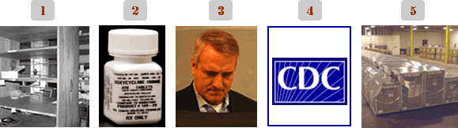

REQUESTING THE SNS
State/Local resources are insufficient or depleted
The Governor and OEPR are advised by the Governor's Expert Emergency Epidemic Response Committee (GEEERC)
OEPR makes the request to CDC
DHHS authorizes deployment of Push Package or Designated Managed Inventory
Notes:
1. Once a health threat becomes too great for the local jurisdiction to respond effectively, local public health and/or the local office of emergency management will notify the Emergency Support Function (ESF) #8 representative at the Multiagency Coordination Center (MACC) to inquire about the availability of state medical resources. If the MACC is not yet activated, local emergency management will contact the Colorado Division of Emergency Management to recommend that the MACC is activated. Local public health will notify the Colorado Department of Public Health and Environment of the health threat and need for resources.
Note: Emergency Support Function (ESF) #8 Health and Medical Services —provides coordinated Federal assistance to supplement State and local resources in response to public health and medical care needs following a major disaster or emergency, or during a developing potential medical situation. Colorado state and local public health is the primary agency responsible for ensuring that ESF #8 functions are conducted prior to, during and after an emergency.
2. The Colorado Department of Public Health and Environment (CDPHE) will activate the COpharm program. If COpharm data shows that Colorado does not have the resources needed to respond to the health threat, the Governor will be alerted and the Governor’s Expert Emergency Epidemic Response Committee known as the GEEERC would be activated. CDPHE will provide the GEEERC with information about the event and recommend to the Governor that the SNS be requested.
3. Once the decision to request the SNS is made, the Governor (or his designee) will contact the Centers for Disease Control and Prevention (CDC) to begin the request process which requires that the Governor (or designee) request federal assistance in writing by faxing the official request to the CDC.

Slide 11
SNS Asset Request Flow
Need for Supplies
Exceeds
Local & State
Resources
State Requests
Federal Assistance
Discussion with key officials
(HHS, DHS, CDC, State, etc)
SNS Augments
Local & State
Resources
Federal Officials
Deploy SNS Assets
Notes:
Know: There doesn’t have to be a disaster or emergency declaration to request SNS assets. Normally, the discover that something is wrong will happen so quickly that there will not be time for typical emergency response measures.
Say:
This chart shows how DSNS assets are deployed to the affected area.
Simply put, first the need is determined at the local level, then the state requests federal assistance and a decision is made at the federal level to deploy the assets. On-going discussions among all organizations and levels ensure critical communication takes place.
Operationally, the governor or his or her designated representative, are the only state officials who can formally request SNS support.
Ideally, the state would determine whether the SNS materiel is needed based on the local inventories available. In a quickly moving situation, or during an event where the state would have no appropriate assets such as during a smallpox outbreak, a deployment decision may be made at the Federal level without a request being made. In this situation, discussion among key officials at all levels is paramount.
Do: Emphasize that although this chart is simple, the amount of information going back and forth and the activities to execute this response will be very complex.
11
DSNS Overview

Slide 12
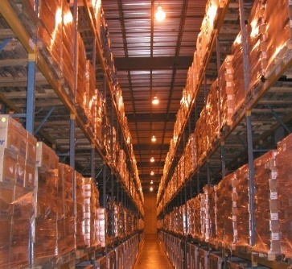
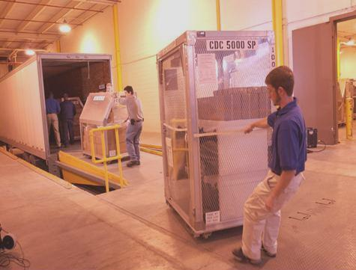

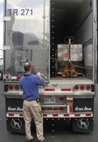
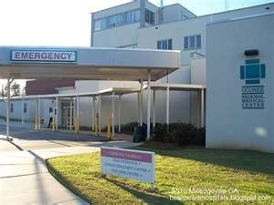



SNS Delivery Sequence
Federal
Storage & Transport
Local
PODs & Treatment Centers
State
RSS Site
Notes:
Know: The different roles the different levels of government will have to successfully execute
Say:
Once we receive the order to deploy, we will work with the affected area to quickly decide how to get the materiel to them as quickly as possible. The federal responsibility is to keep the materiel ready to go and to get it to a single point at the state.
The state has to receive the material to get it ready to ship to treatment centers or points of dispensing or PODS. PODs will be the ad hoc sites where the affected population will receive the drugs to prevent them from getting ill. The state receiving sites is a warehouse we refer to as the “receive, stage, store” site or “RSS”.
The SNS can be shipped to the affected area by air or directly by truck. If by air, it will be off loaded onto trucks to be delivered to the RSS.
Also, the materiel is the responsibility of DSNS until someone at the RSS site signs for it. At that point it becomes the responsibility of the state.
Finally, is a “local” responsibility to get the preventative medications to the affected population. “Local” could be county, city, regional…It just depends on how the state and local authorities organize themselves to do this mission.
Do: Ensure the audience understands this distinction of the different roles each level of government must play as this is a learning objective.
12
DSNS Overview

Slide 13






Colorado Distribution Process
Receipt, Store and Stage (RSS)
Regional/Local Transfer Points (RTP/LTP)
Points of Dispensing (PODS)
CDPHE
LPHA

Slide 14
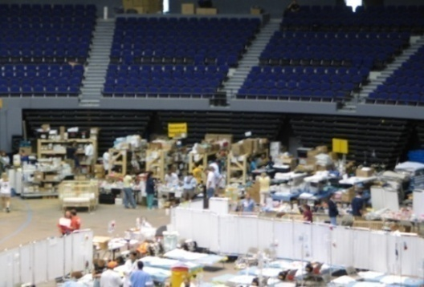

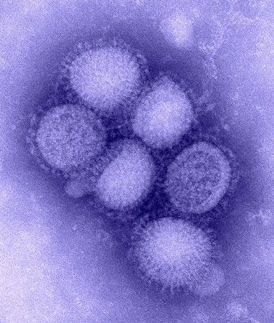
SNS Response History
2001 New York City 9/11 Attacks and 2001 Anthrax
2005 Hurricanes Katrina & Rita
2009 H1N1
2010 Haiti Earthquake and Red River Floods in North Dakota
2011 Hurricane Irene and Japan Earthquake
2012 Superstorm Sandy (Federal Medical Stations)
2016 Zika Response-USVI, Puerto Rico, American Samoa (pregnancy kits)
Notes:
Say:
The SNS has been deployed during real-world emergencies, and has proven to be a fast, flexible response that stays until the job is completed. This shows just a few of the incidents we have responded to.
During the 9-11 response, the SNS had advisory teams on the ground within 3 hours, initial medical supplies were on the ground within 7 hours, and additional supplies arrived within 12 hours.
Probably not as well known as our 9-11 response, we also supported operations during the October 2001 Anthrax Response. Over 70 shipments of medical materiel, were delivered in support of local operations. The total response effort included shipments of antibiotics, medical supplies, lab samples sent to CDC, and response teams. The effort was conducted in 9 states and Washington DC. Advisors were deployed to six locations.
In 2005, the DSNS sent two TARU Teams to Mississippi and Louisian in response to Hurricane Katrina. The DSNS also shipped and supported the project areas with Federal Medical Stations which were very new and still being developed at the time of the response.
Shortly after Katrina, Hurricane Rita struck Texas and the DSNS sent a TARU Team and FMS in response to that incident.
During both emergencies, DSNS advisory personnel were on the ground supporting Federal Medical Stations (FMS) FMS is designed to provide non-acute medical services and quarantine support for 250 individuals.
We continue to support natural disasters and incidents with FMS. Examples are the Red River floods in 200- and 2010 and Hurricanes. We also provided material to USAID to provide assistance in Haiti.
The DSNS sent a liaison to Japan in response to the earthquake and tsunami in 2011.
The DSNS remains trained and ready to respond quickly whenever and wherever needed.
More recently, we kept our pulse on how H1N1 was impacting the US and the world and responded when called upon to do so.
14
DSNS Overview

Slide 15
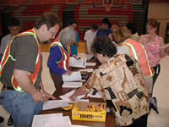
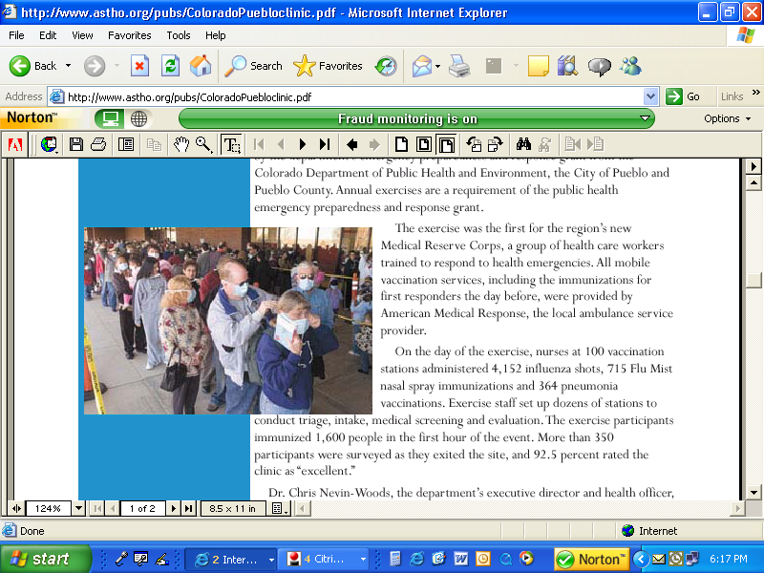
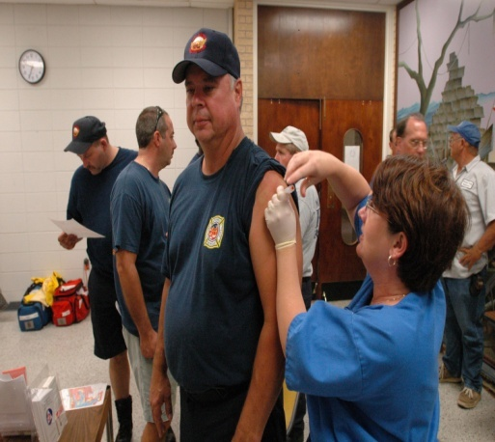
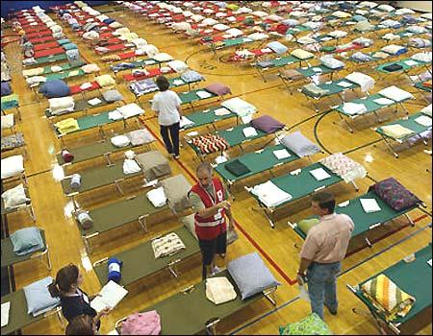
Points of Dispensing (PODs) for Mass Vaccination/Prophylaxis and Medical Surge

Slide 16
What is Prophylaxis?
(Clue: it is not a contraceptive device)
Prevention of or protective treatment for disease and control of its possible spread
Antibiotics
(eg. Doxycyline, Ciprofloxacin, Levofloxacin, Amoxicillin)
Antivirals
(eg. Tamiflu, Relenza)
Vaccine
(eg. Influenza, Smallpox, Anthrax)

Slide 17
State Planning Considerations for Mass Prophylaxis
What is the incident?
- Terror Event, i.e. Anthrax (antibiotics)
- Pandemic Flu i.e. H1N1 (antivirals, vaccine)
What is the availability of other resources in state?
Are distribution operations ready to activate? (RSS, RTPs, transportation, security, staff)
How will assets be delivered to POD sites?
How quickly can dispensing sites be opened and meds dispensed to the public?
How many staff and volunteers are available to assist with distribution and dispensing operations?
Notes:
Incident – Mass prophy vs Mass Dispensing
H1N1 – PODs and SNS
Exercise March 2013

Slide 18
Regional/Local Planning
Considerations for Dispensing and Prophylaxis
How will we dispense to the public?
  Public Points of Dispensing (PODs)
  Closed PODs
  Home delivery to those with functional and special needs
Do our POD and RTP sites have adequate transportation and security and security plans?
Do we have MOUs/MOUs in place for certain resources (eg. volunteers, food, essential employee med caches)
Who will staff our PODs? (eg. LPHAs, county employees, MRC volunteers, Behavioral Health staff)
How do we request Medical Supplies? Non-medical supplies?
Notes:
Describe POD types and planning, data driven methodology to identify locations, staffing and flow
Legal processes for agreements with partners
Staffing mechanisms and training and identifying people to fill key positions
Asset management for all of the things needed to stand up a POD
Familiar to community
Easy access
Secure
Size considerations
First responders through local inventories
Security

Slide 19
Point of Dispensing (POD) Types
Open (Public) PODs
Closed (Employee) PODs*
Schools
Fairgrounds
Sports Arenas
Local Health Departments
Community Centers
Large Businesses
Universities
HMOs (eg. Kaiser)
Health facilities (eg. Nursing Homes)
State/Federal Agencies
Military Bases
* includes family members

Slide 20
Closed POD Planning Objectives
Explain why rapid medication dispensing might be needed.
Define closed Points of Dispensing (PODs).
Identify the benefits of being a closed POD partner.
Learn how to register your organization.

Slide 21
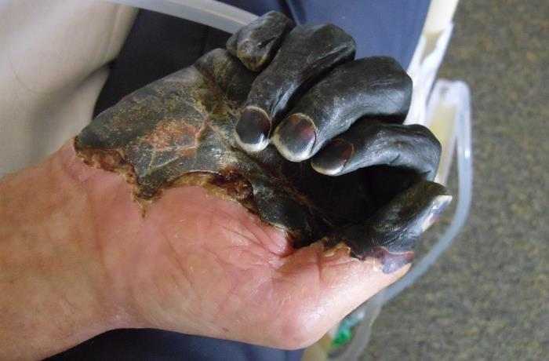
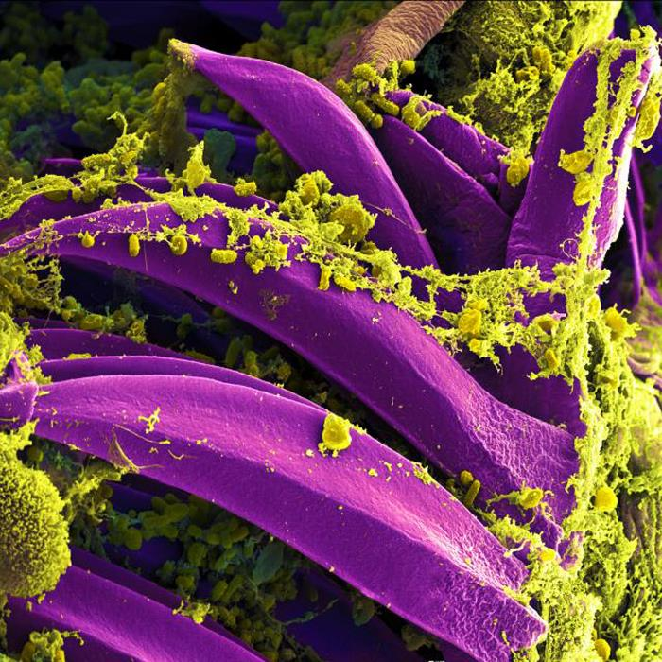
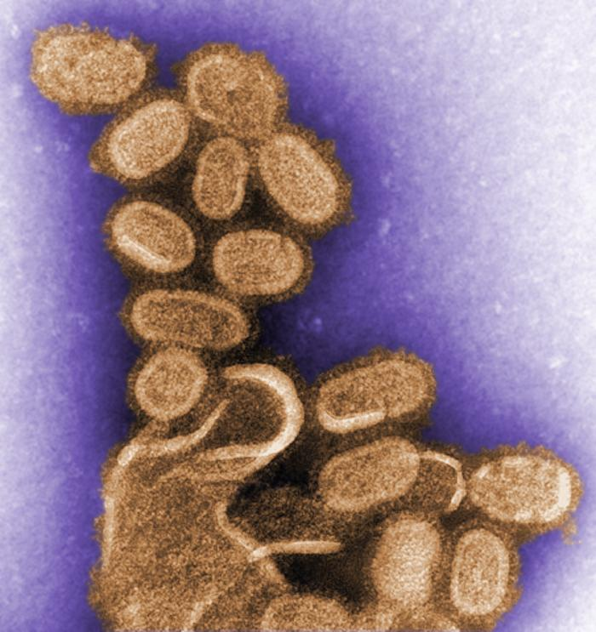

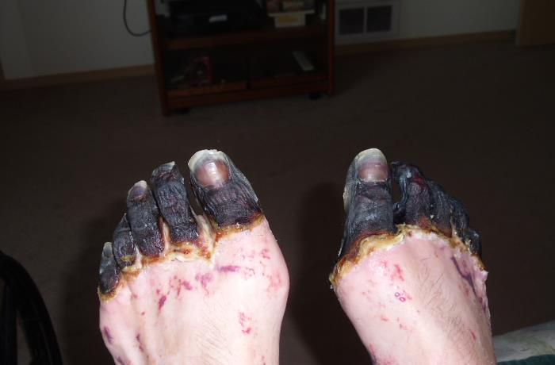
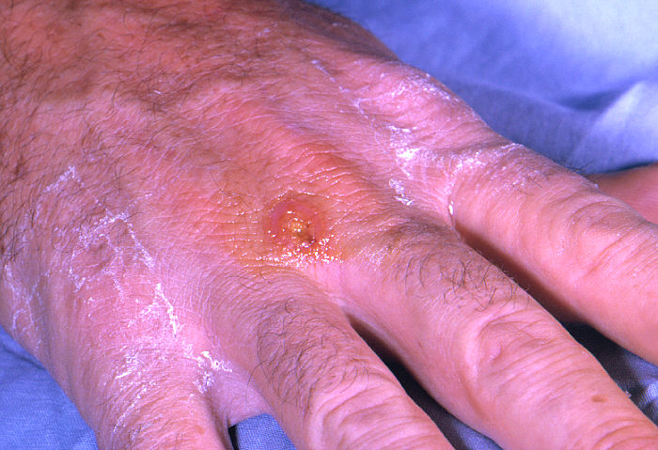
Biological Threats
Notes:
Category A agents include organisms or toxins that pose the highest risk to the public and national security because:
-They can be easily spread or transmitted from person to person
-They result in high death rates and have the potential for major public health impact
-They might cause public panic and social disruption
-They require special action for public health preparedness.
Pictured, counterclockwise from top: plague, tularemia, and the 1918 influenza (though not a Category A agent, still caused a massive number of deaths).

Slide 22
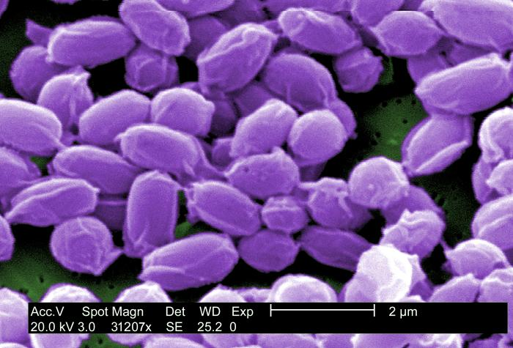

Anthrax
Anthrax spores:
  Are easily found in natural environments or produced in the lab
  Last a long time in the environment
  Can be easily hidden
It only takes a small amount of Anthrax to infect a large number of people.
Notes:
-Anthrax has been used as a weapon around the world for nearly a century. In 2001, powdered anthrax spores were deliberately put into letters that were mailed through the U.S. postal system. Twenty-two people, including 12 mail handlers, got anthrax, and five of these 22 people died.
-Can also be added to food or water sources.

Slide 23
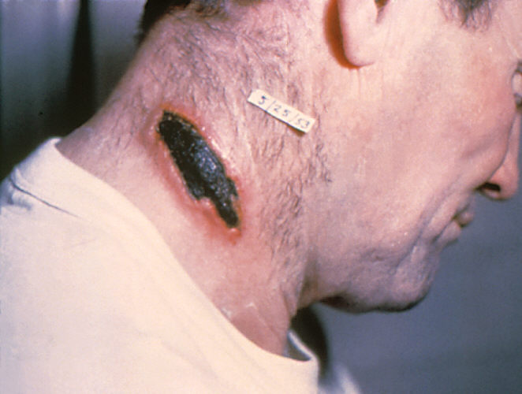
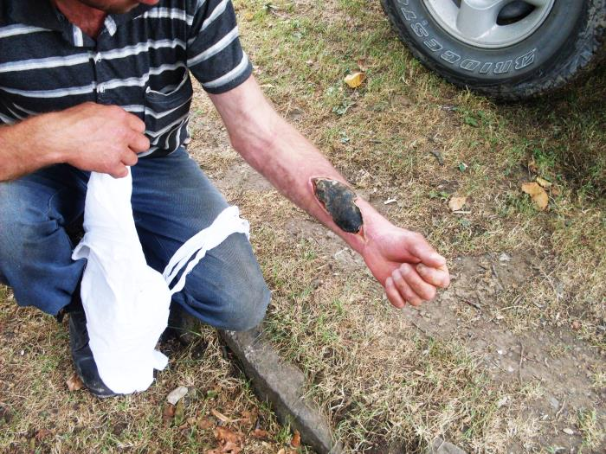
Anthrax, cont.
Notes:
-Typically, anthrax gets into the body through the skin (cutaneous) , lungs (inhalation), or gastrointestinal system.
-Perhaps the most dangerous scenario would be a release into the air. This type of attack would mean the anthrax spores could easily be blown around by the wind or carried on people’s clothes or shoes. Without treatment, only a small percentage of those infected survive.
-All types of Anthrax are deadly without antibiotics.

Slide 24
Prevention is Key
Anthrax spores typically take 2-7 days to activate, but can take as long as 60 days.
Antibiotics prevent Anthrax spores from activating.
        Ciprofloxacin (“Cipro”)
        Doxycycline (“Doxy”)
        Amoxicillin

Slide 25
What are Closed PODs?
Public Health provides medications for your residents, staff, and their families and your organization dispenses them.
Here in Colorado, we already have a number of agencies that have agreed to serve as a Closed POD.
      Kaiser Permanente
      National Guard
      Universities
      Colorado Department of Corrections

Slide 26
What’s in it for me?
Benefit your organization.
      Protect your own.
      Help ensure you can continue to operate.
      Exhibit your commitment to our community.
  Help Public Health do the right thing.
      With your help, we get medications to more people, sooner.
      When people receive medications at a Closed POD, it decreases the number of people at open PODs.

Slide 27
What does this entail, exactly?
Designate liaisons to coordinate with Public health.
      If the scope of your agency is statewide or crosses multiple regions, CDPHE may be your point of contact.
      If the scope of your agency is limited to one or more counties, a county public health department will be your point of contact.
Develop a Closed POD Plan.
      Public Health can provide a template and technical assistance.
  Participate in training and exercising opportunities.
  Operate your Closed POD during an emergency.

Slide 28

Public Health will help you make a plan.
We’ll work with your liaisons to come up with effective strategies for:
      Flow
      Staffing
      Communication
      Logistics
      Dispensing
      Security

Slide 29
Will my staff be protected?
The Public Readiness and Emergency Preparedness (PREP) Act is a federal law that was enacted to address concerns about liability related to countermeasures taken in response to a variety of public health emergencies.
      The PREP Act provides immunity from tort liability (except for willful misconduct) for claims of loss caused, arising out of, relating to, or resulting from administration or use of disaster countermeasures.
      Immunity is given to manufacturers of countermeasures, distributors of countermeasures, program planners of countermeasures, and qualified persons who prescribe, administer, or dispense countermeasures (i.e., POD Staff).

