Slide 1
Ebola and Zika Response in Colorado

Slide 2
What is Ebola Virus Disease (Ebola)?
Ebola is a hemorrhagic fever that can cause disease in humans and nonhuman primates (monkeys, gorillas, and chimpanzees)
Ebola is spread through direct contact (through broken skin or unprotected mucous membranes) with:
Blood or bodily fluids
Objects that have been contaminated with the virus
Infected fruit bats or primates
From contact with semen from a man who has recovered from Ebola

Slide 3
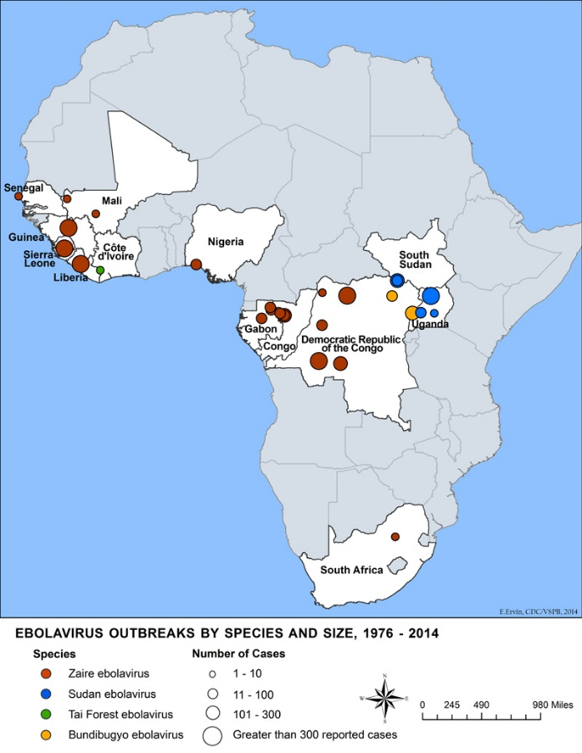
Where has Ebola been found?
Ebola viruses are found in several African countries.

Slide 4
Colorado’s preparedness strategy
OEPR, DCEED, HFEMS, Lab
LPHA’s
Monitoring (traveler and worker)
PUI
Quarantine/Isolation
Hospitals
Tiered approach (frontline-assessment-treatment)
‘Ask, Isolate, Call’
Patient assessment and treatment
EMS
Transport
Labs
Testing (Malaria, other diseases)
Overarching
Infection Control
Communication
Waste Management
Resources
Training

Slide 5
Ebola funding strategy
PHEP Grant
HPP Grant

Slide 6
Public Health Emergency Preparedness (PHEP)
Phase I
12/22/2014 – 6/30/2015
$68,000
Ebola monitoring activities
Closed out
Phase II
4/1/2015 – 9/30/2016
$2,197,741
Algorithm = Base amount + traveler numbers
Ebola preparedness and response activities
Planning, Training, Exercising, Monitoring
No-fund extension
June 30, 2017
Addition of Other Infectious Diseases

Slide 7
Hospital Preparedness Program (HPP)
Part A
5/18/2015 – 5/18/2020
$2,394,069
Development of tiered patient care system
Frontline (all) - Assessment (5) - Treatment (3)
Transport (3)
Lab
‘Ask, Isolate, Call’
PUI Protocol
CONOPs

Slide 8
Hospital Preparedness Program (HPP)
Part B
5/18/2015 – 5/18/2020
$3,250,000
Regional Treatment Center
HHS Region 8
Nationwide
‘Ask, Isolate, Call’ and PUI Protocol
Lab, Colorado CONOP
Regional CONOP
Assist area facilities

Slide 9
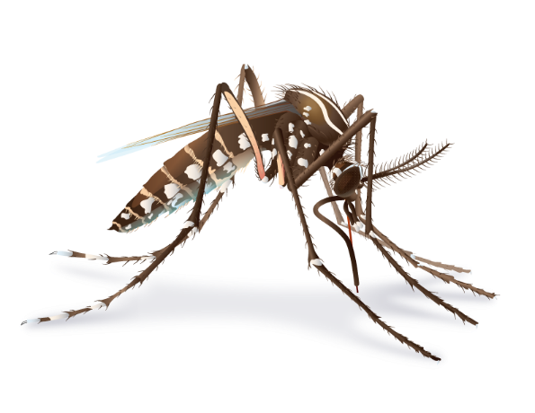
What is Zika?
Zika virus is spread to people primarily through the bite of an infected Aedes species mosquito (Ae. aegypti and Ae. albopictus).
Many people infected with Zika virus won’t have symptoms or will only have mild symptoms.
Zika virus infection during pregnancy can cause microcephaly and other severe brain defects.

Slide 10
Where has Zika been found?
Before 2015, Zika outbreaks occurred in Africa, Southeast Asia, and the Pacific Islands.
Currently outbreaks are occurring in many countries and territories.
http://www.cdc.gov/zika/geo/index.html

Slide 11
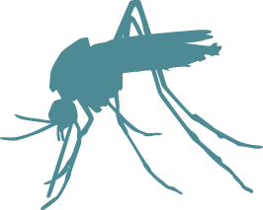
How is Zika spread?
Zika can be spread through
Mosquito bites
From a pregnant woman to her fetus
Sex with an infected person
Laboratory exposure
Zika may be spread through blood transfusion.
No reports of infants getting Zika through breastfeeding.

Slide 12
Snapshot of Zika in Colorado
Colorado anticipates an extremely low probability of a mosquito transmitted Zika virus outbreak. To date, Colorado has not had any locally acquired cases.

Slide 13
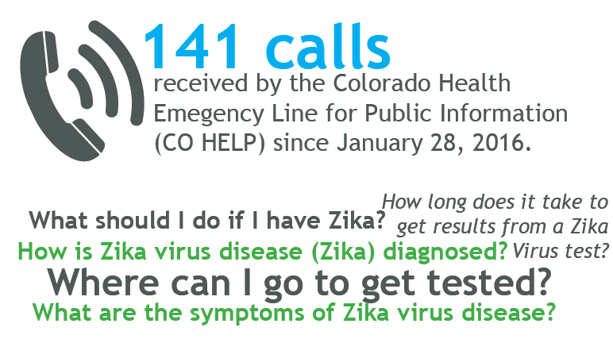
Snapshot of Zika in Colorado

Slide 14
Colorado’s preparedness strategy
On July 1, 2016, the Colorado Department of Public Health and Environment’s Office of Emergency Preparedness and Response was awarded $253,357 in grant funding from the Centers for Disease Control and Prevention for Zika activities
Information management and sharing, and community recovery and resilience are the focus for these particular funds via the creation of a community outreach campaign

Slide 15
Colorado Zika Funding Strategy
($253,357)
Local Public Health Agencies (LPHA) and Tribal Nations
54 Local Agencies
- $3,000 base amount per LPHA and Tribal Nation
- 2 CDC designated counties will receive an additional $2,000 (Baca & Weld)
Locally designated for:
- Outreach & Education
- Print Materials
- Staff Time
65.5%
Federally Qualified Health Centers, Rural Health Clinics, and Commercial Airports
53.45%

Slide 16
Colorado’s preparedness strategy

Slide 17
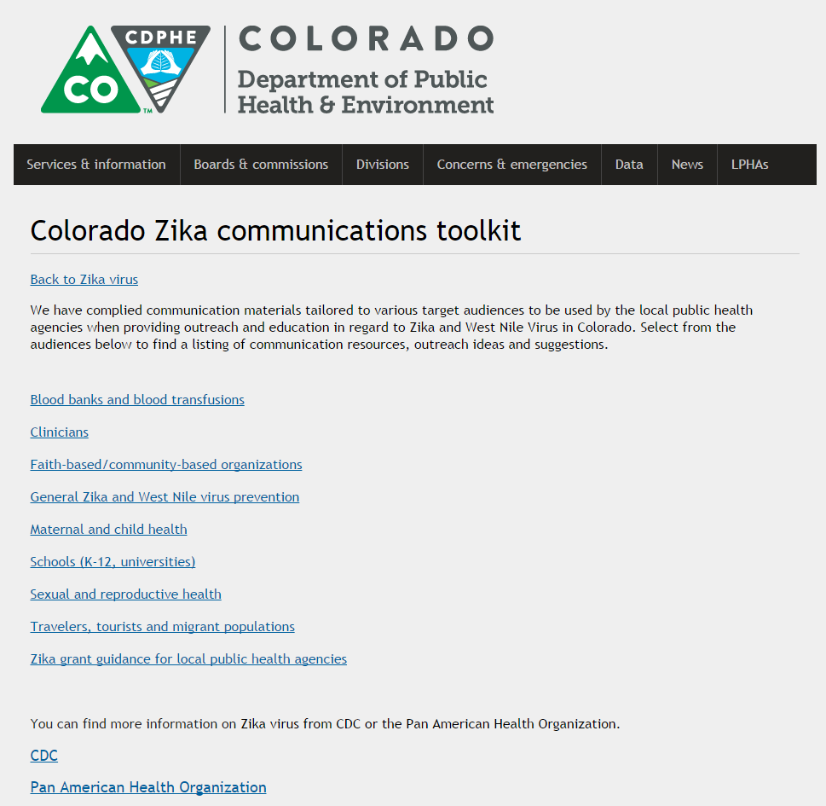
Zika communications toolkit
https://www.colorado.gov/pacific/cdphe/colorado-zika-communications-toolkit

Slide 18
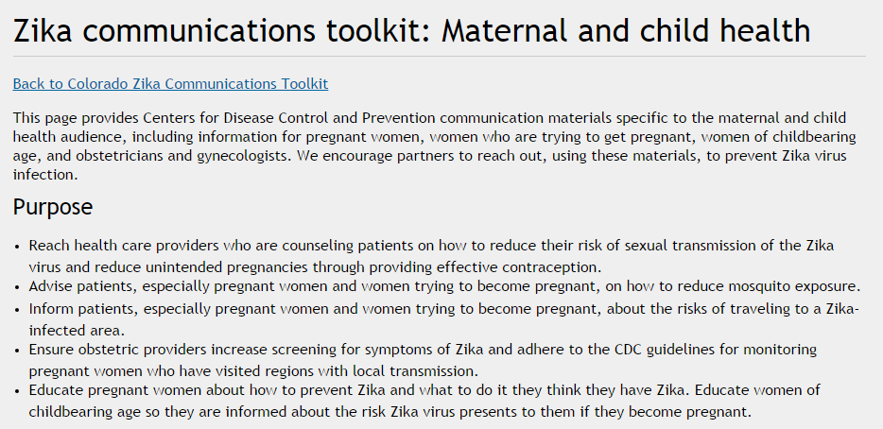
Zika communications toolkit – Purpose

Slide 19
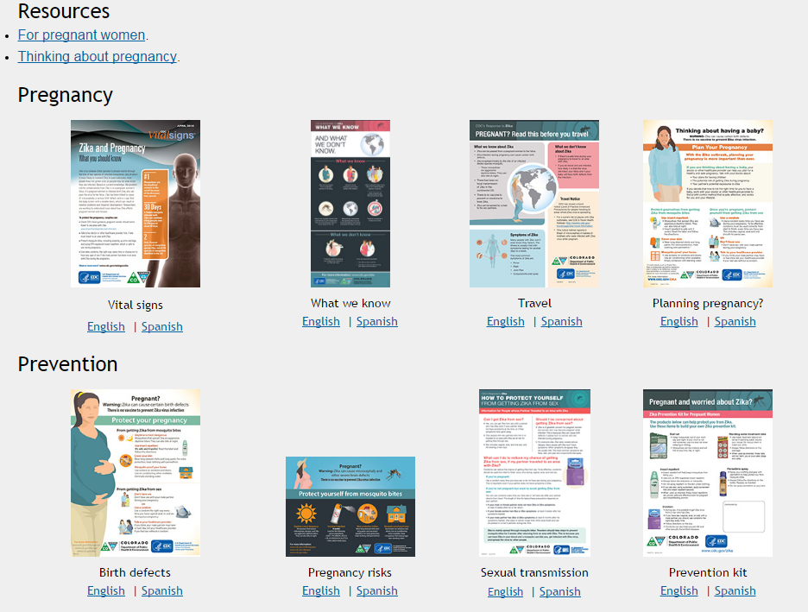
Zika communications toolkit - Resources

Slide 20
Zika communications toolkit – Outreach ideas and suggestions

Slide 21
Zika communications toolkit
750+
Zika Toolkit homepage visits
from Aug-Sept 2016

Slide 22
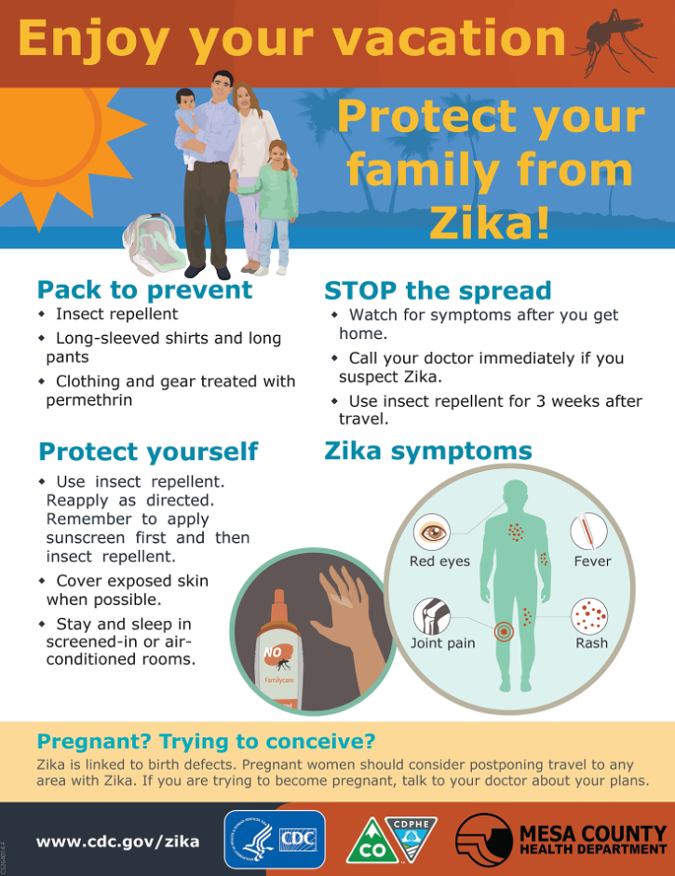
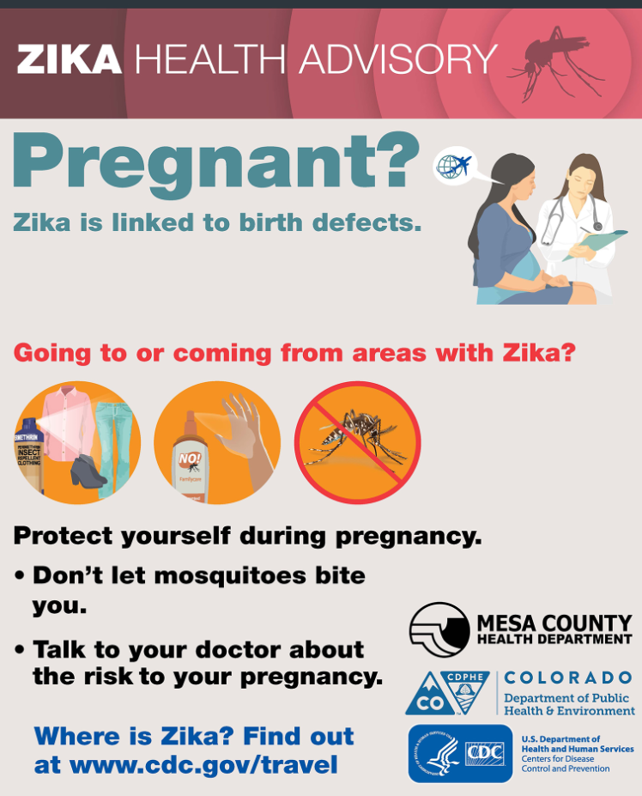
Zika outreach to airports

